Slide 1
Deformable Image registration
By Pronoma Banerjee

Slide 2
Contents
Introduction (slides 1-3)
Image registration classification (4)
Algorithmic classification + steps involved in feature based registration (5-11)
Criteria to choose an image registration technique (12)
Methods of image registration (13-15)
Rigid vs non-rigid image registration (16)
Deformable image registration (17-18)
Main objective, existence of solution (19-20)
Performance analysis (21-23)
Components: (24-40)
Difficulty in evaluation of registration methods (41)
Deformable registration using python libraries (42)
References (43-45)

Slide 3
Image registration
Process of transforming different sets of data into one coordinate system.¹
Finding corresponding structures and determining optimal transformation to correct the misalignment of the images and apply the transformation (image fusion).
Spatially transforming the target/subject/moving image(s) to align with the fixed/reference/source image.¹

Slide 4
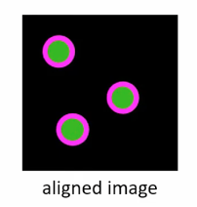
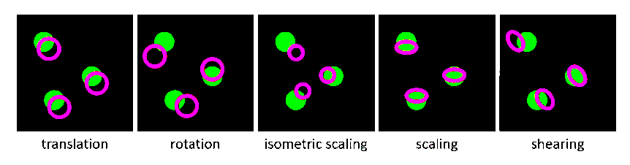
Spatial transformations
Types of misalignment ² (linear deformation models)

Slide 5
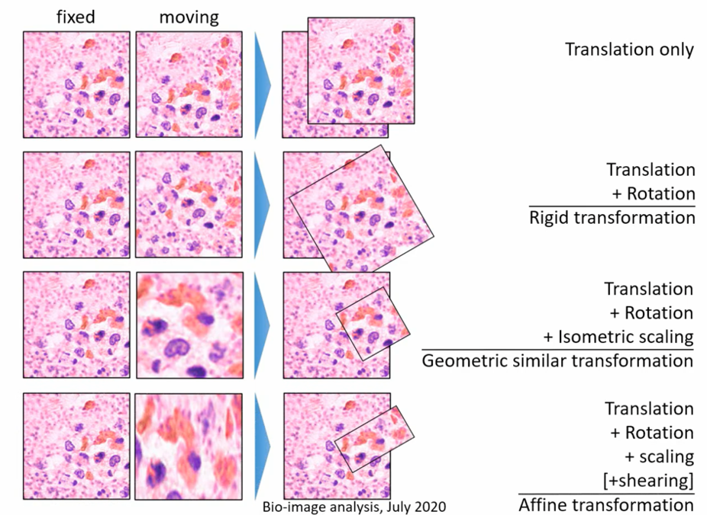
Spatial transformations ²

Slide 6
Image registration: classification
According to the manner of image acquisition the application of Image Registration can be segregated into the following groups:¹⁵
Multi-view Analysis: Images of the similar object or scene are captured from multiple viewpoints to gain a better representation of the scanned object or scene.
Multi-temporal Analysis: Images of the same object/ scene are captured at various times usually under dissimilar conditions to notice changes in the object/ scene which emerged between the successive images acquisitions.
Multi-modal Analysis: Different sensors are used to acquire the images of the same object/scene to merge the information obtained from various sources to obtain the details of the object/scene.

Slide 7
Algorithm classification ¹
Feature based:
Establishing correspondence between image features such as points, lines, and contours.
Determining a geometrical transformation to map the target images to the reference image.
Intensity-based:
Compare intensity patterns in images via correlation metrics.
Find a geometrical transformation to map the target images to the reference image.

Slide 8
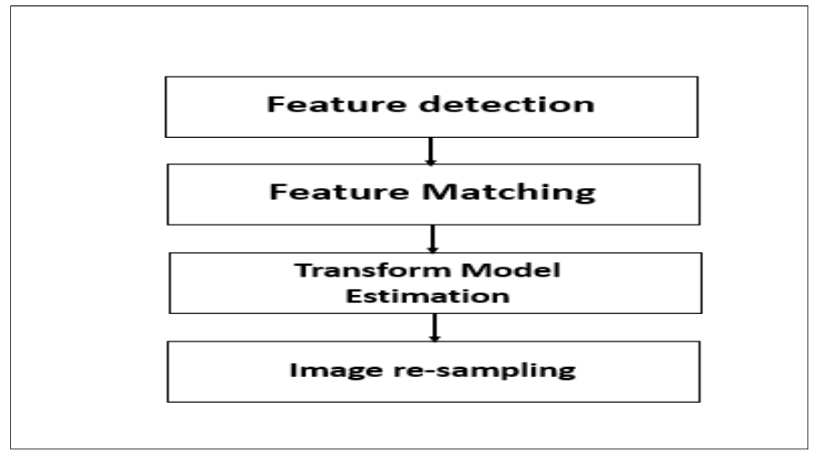
Steps involved in feature based image registration¹⁵

Slide 9
Steps involved in feature based image registration
Feature detection: Features must be easily detectable, physically interpretable and identifiable. The feature set of the reference image must be sharing sufficient common features with the non-aligned image(s). The algorithm for detection should be robust enough to be able to detect the same features in all projections of the scene without being affected by any specific image deformation or degradation.¹⁵
Feature matching: This step essentially establishes the correspondence between the features detected in the non-aligned sensed image and those detected in the reference image. The feature descriptors must remain unchanged in spite of any degradations and concurrently discriminate among diverse features while remaining unaffected by noise.¹⁵

Slide 10
Steps involved in feature based image registration
Transform model assessment (main objective³): For alignment of the sensed image with the reference image the parameters of the mapping functions are to be estimated. These parameters are computed with the established feature correspondence obtained from the previous step. The selectivity of a mapping function depends on a priori knowledge regarding the acquisition process and expected image deformations. In absence of any a priori information the flexibility of the model must be ensured to tackle image deformations.
Image transformation: The sensed image is transformed for alignment employing the mapping functions.¹⁵

Slide 11
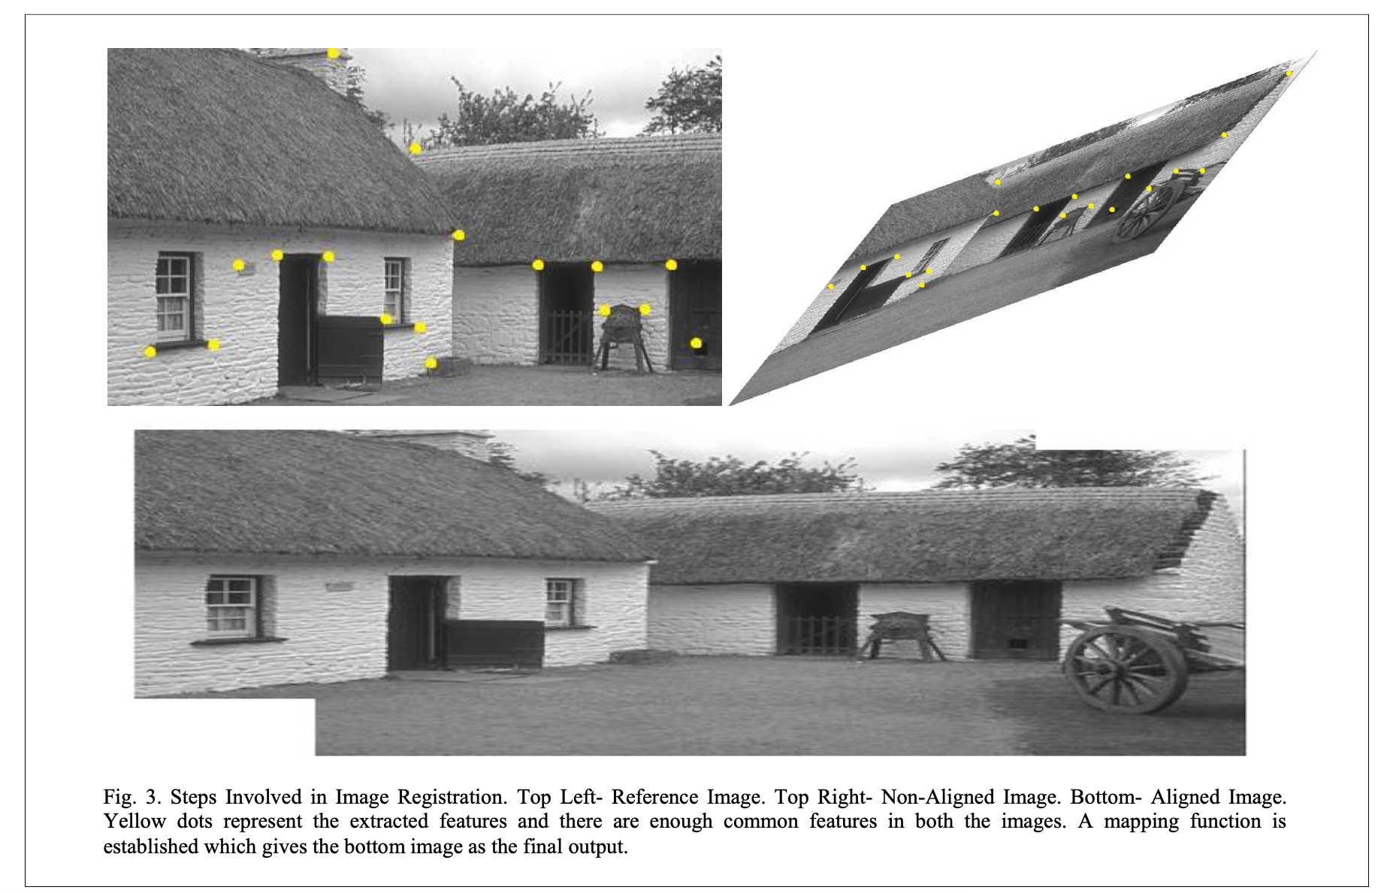
Steps involved in feature based image registration

Slide 12
Criteria to choose an image registration technique
Dimensionalities
Domain of transformation
Type of transformation
Registration Quality
Parameters of Registration
Subject of Registration
Object of Registration
Nature of Registration basis
Interaction
Modalities involved

Slide 13
Methods of image registration
Extrinsic methods
Surface methods
Moments and Principle Axes Methods
Correlation Based Methods
Mutual Information Based Methods
Wavelet Based Methods
Soft Computing Based Methods
Artificial Neural Networks
Fuzzy Sets
Optimization Heuristics

Slide 14
Performance analysis
It is required to estimate how accurate the registration actually is. Also to qualitatively analyze the performance of the algorithms some metrics are used. They also serve as the basis for improvement in the registration in each iteration. Correlation based metrics like Correlation Coefficient is applicable to mono-modal registration and Mutual Information is utilized for multi-modal image registration purposes. ¹⁵

Slide 15
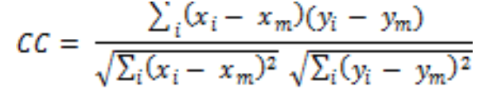
Correlation Coefficient (CC)¹⁵
CC is essentially a similarity measure which gives an idea of how well the reference and transformed images are identical. If two images are perfectly identical, CC gives a value equal to 1, whereas, if the two images are completely uncorrelated CC value is equal to 0 and CC value equal to -1 indicates that the images are completely anti-correlated, which means one image is the negative of the other. It gives satisfactory results with mono-modal registration. It is represented as:
where x_{i} , y_{i} = intensity of ith pixel in the reference and sensed image respectively, and x_{m} , y_{m} = mean intensity of reference and sensed image respectively.

Slide 16
Correlation based methods¹⁵
This method is essentially useful for registration of mono-modal images and for comparison of several images of the similar object. It has immense usage in the field of medical sciences for analyzing and treatment of disease. Extracted features from the images are also used to obtain the cross-correlation coefficients for image registration. Cross-correlation and Phase-correlation techniques based on Fourier domain are also used for image registration. Normalized mutual information between the images have been used for image registration purposes adopting an Entropy Correlation Coefficient (ECC)¹⁶. Fourier-based techniques accompanied by search algorithms have been exploited to evaluate the transformation between two input images.

Slide 17
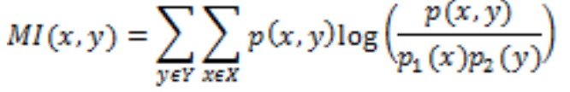
Mutual Information (MI)¹⁵
MI is yet another measure determining the degree of similarity measured between the image intensities of corresponding voxels in both images. MI is maximized when both the images are accurately aligned. The values of MI are non-negative and symmetric. The range of MI values starts from zero and can vary up to a high value. High MI value depicts large reduction in uncertainty whereas zero MI value is clear indication that the two variables are independent. It is represented as:
where p(x, y) = joint distribution function and p₁(x) , p₂(y) = marginal distribution functions.

Slide 18
Mutual Information Based Methods¹⁵
In mutual information-based registration methods the joint probability of the intensities of comparable voxels in the images under consideration are estimated. Mutual information based measures are utilized to aid Voxel-based Registration. Mutual information can be fruitfully utilized for establishing the correspondence between the features of the reference and the sensed images as mentioned in the step of feature-matching. Correlation methods have proved inefficient for multi-modal registration. But, the mutual information based methods do not suffer from such a problem, rather they are found to perform effectively in multi-modal registration tasks. Gradient descent optimization methods have been employed to maximize mutual information. Recently various optimization methods and multi-resolution strategies have been adopted for mutual information maximization.

Slide 19
Rigid versus non-rigid image registration
Rigid
Applying transformation to whole image where all pixels are transformed in the same way.
Non-rigid
The reference and moving images are locally misaligned. Transformation of pixels may be different depending on regions in the image. Non-linear registration.

Slide 20
Deformable image registration
Locally registering image data sets into a reference image set.
The term deformable (as opposed to linear or global) is used to denote the fact that the observed signals are associated through a nonlinear dense transformation, or a spatially varying deformation model.³
Also known as:
Non-rigid registration
Non-linear registration
“Optical flow measurement”
“Particle image velocimetry”

Slide 21
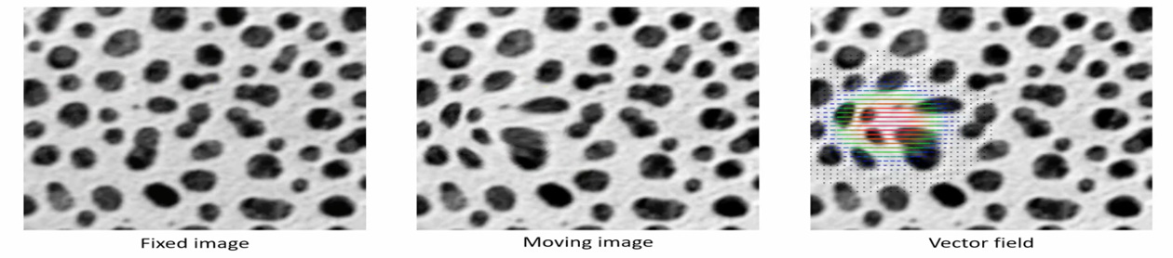
Deformable image registration
Transformation of pixels are different depending on regions in the image.
The transformations are typically quantified or visualized through vector fields.²

Slide 22
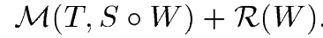
Main objective³
To estimate the optimal transformation that optimizes the objective function:
The first term, M, termed interchangeably as the matching criterion, (dis)similarity criterion or distance measure, quantifies the level of alignment between a target image and a source image. The images get aligned under the influence of transformation W. The second term, R, regularizes the transformation aiming to favor any specific properties in the solution that the user requires, and seeks to tackle the difficulty associated with the ill-posedness of the problem. The optimization problem consists of either maximizing or minimizing the objective function depending on how the matching term is chosen.

Slide 23
Existence of solution for objective function
Given nonlinear and nonconvex objective functions, in general, no closed-form solutions exist to estimate the registration parameters. In this setting, the search methods reach only a local minimum in the parameter space. Moreover, the problem itself has an enormous number of different facets. The approach that one should take depends on the anatomical properties of the organ (for example, the heart and liver do not adhere to the same degree of deformation), the nature of observations to be registered (same modality versus multi-modal fusion), the clinical setting in which registration is to be used (e.g., offline interpretation versus computer assisted surgery).³

Slide 24
Image registration algorithm: components³
A deformation model
An objective function
An optimization method
Image registration is inherently ill-posed, leading to the dependency of the registration result on the optimization method.
In deformable registration, one seeks to estimate a vector for every position given. The number of unknowns is greater than the number of constraints.

Slide 25
Deformation models
Choice of deformation models is important in the registration process because:³
It entails an important compromise between computational efficiency and richness of description.
It reflects the class of transformations that are desirable or acceptable, and therefore limits the solution to a large extent.
The parameters that registration estimates through optimization strategy correspond to the degrees of freedom of the deformation model.
Increasing the dimensionality of the state space results in enriching the descriptive power of the model, which may be accompanied by the increase in the model’s complexity, which in turn results in more challenging and computationally demanding inference.
It implies an assumption regarding the nature of the deformation to be recovered.

Slide 26
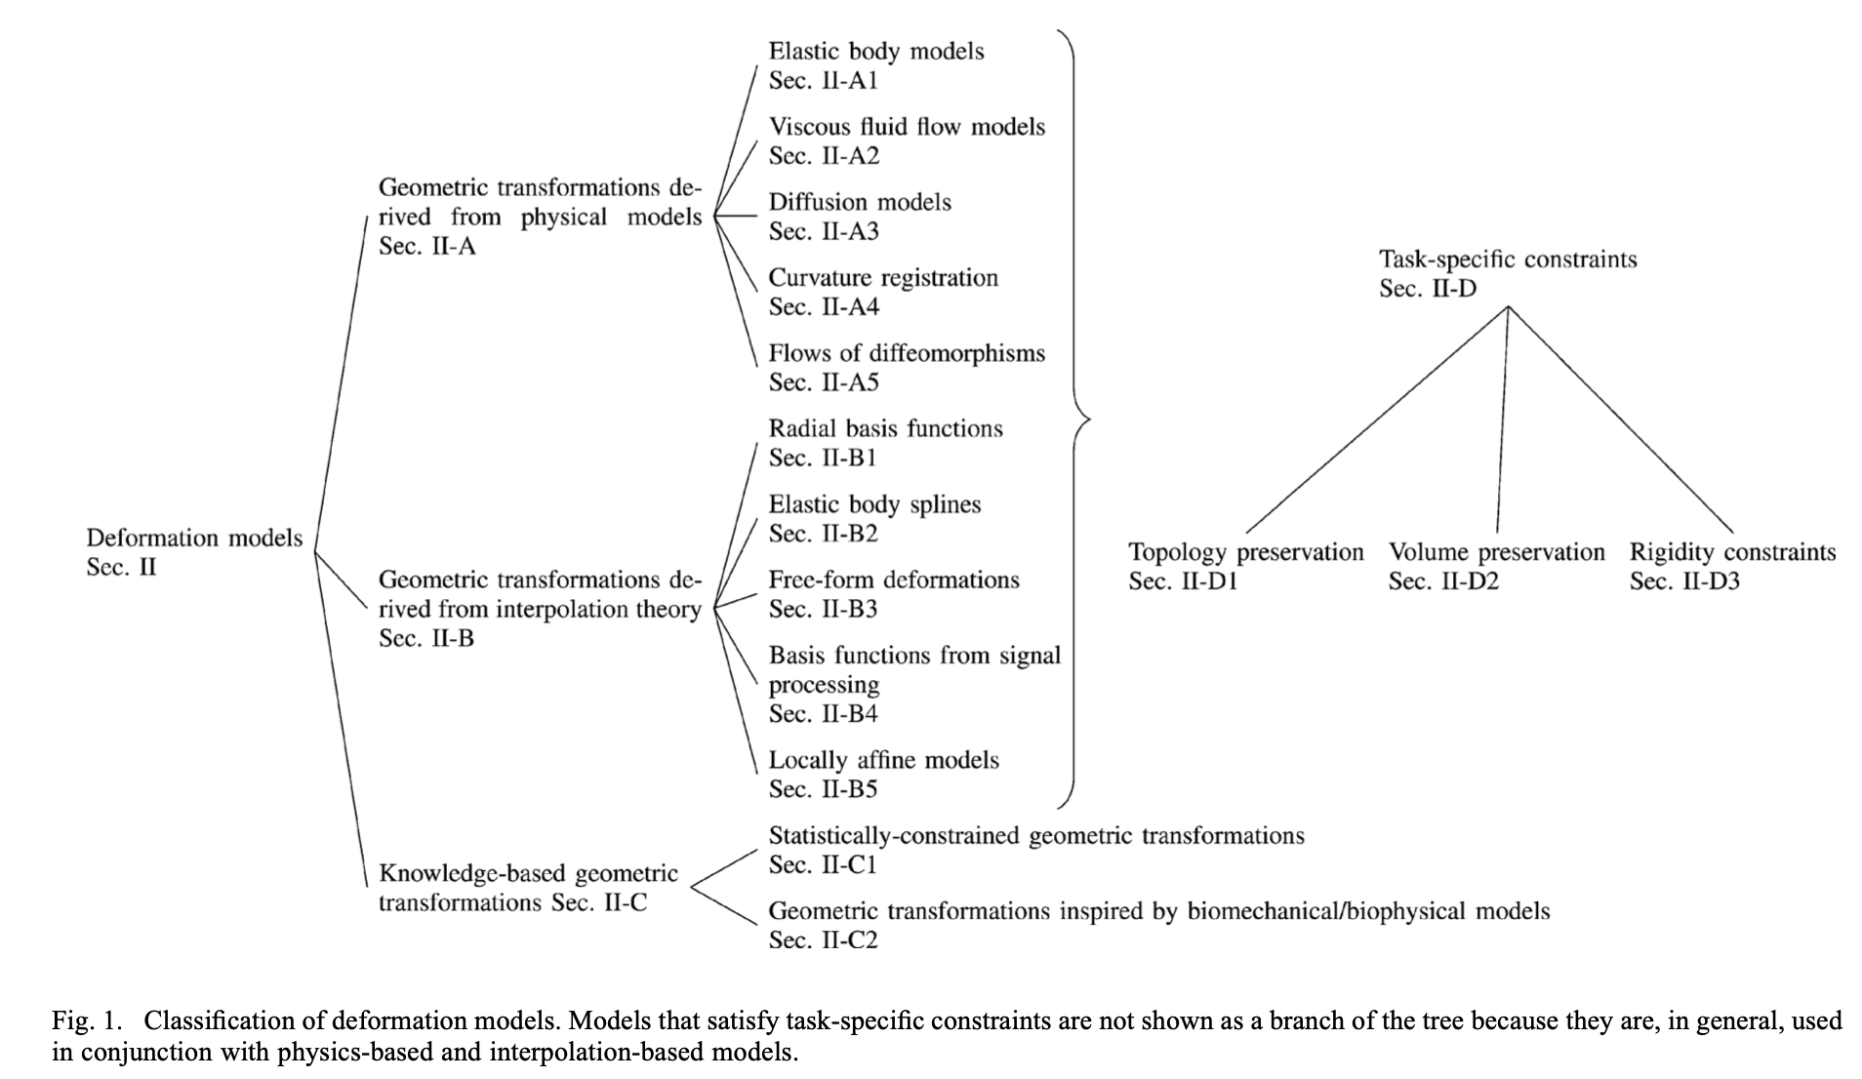
Classification of deformation models³

Slide 27
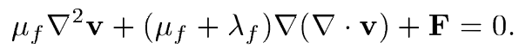
Viscous fluid flow models³
In viscous fluid flow model, the image under deformation is modeled as a viscous fluid. The transformation is governed by the Navier-Stokes equation that is simplified by assuming a very low Reynold’s number flow.
These models do not assume small deformations, and thus are able to recover large deformations. The first term constrains neighboring points to deform similarly by spatially smoothing the velocity field. The velocity field is related to the displacement field as v(x,t) = 𝛿_{t}u(x,t) + ▽u(x,t)v(x,t). The velocity field is integrated in order to estimate the displacement field. The second term allows structures to change in mass while 𝜇_{f} and ƛ_{f} are the viscosity coefficients.

Slide 28
Multimodal registration with fluid deformation models⁴
D’Agostino et al. tackled multi-modal non-rigid registration using with the use of a viscous fluid model (Navier-Stokes equation: 𝜇_{f} = 1, ƛ_{f}= 0) in [4]. The algorithm is based on maximization of mutual information.
The warped image is modeled as a viscous fluid that deforms under the influence of forces derived from the gradient of the mutual information registration criterion.
The accuracy of the method is verified using simulated multi-modal MR images with known ground truth deformation. The results show that the root mean square difference between the recovered and the ground truth deformation is smaller than 1 voxel.

Slide 29

Diffusion models and Demon’s algorithm
In this case, the deformation is modelled by the diffusion equation:
Thirion, inspired by Maxwell’s Demons, proposed to perform image matching as a diffusion process, in [5]. The proposed algorithm iterated between two steps:³
Estimation of the demon forces for every demon (more precisely, the result of the application of a force during one iteration step, that is a displacement)
Update of the transformation based on the calculated forces.
The paper uses the concept of diffusing models to derive three different non-rigid matching algorithms, one using all the intensity levels in the static image, one using only contour points, and a last one operating on already segmented images.⁵

Slide 30
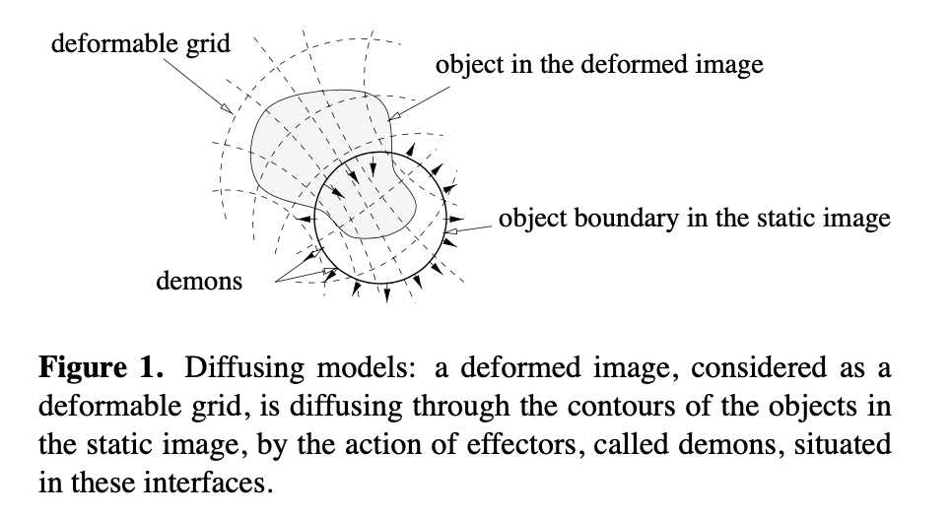
Diffusion models and Demon’s algorithm⁵

Slide 31
Diffusion models and Demon’s algorithm³
Depending on the way the demon positions are selected, the way the space of deformations is defined, the interpolation method that is used, and the way the demon forces are calculated, different variants can be obtained.
The most suitable version for medical image analysis involved:
Selecting all image elements as demons,
Calculating demon forces by considering the optical flow constraint,
Assuming a nonparametric deformation model that was regularized by applying a Gaussian filter after each iteration, and
A trilinear interpolation scheme.
The methods described by Thirion share the iterative approach, that is, iterating between estimating the displacements and regularizing to obtain the transformation. This iterative approach results in increased computational efficiency.

Slide 32
Demon’s algorithm: literature review³
In 1999, Pennec et al. in [6] studied image registration as an energy minimization problem and drew the connection of the Demons algorithm with gradient descent schemes. Thirion’s image force based on optical flow was shown to be equivalent with a second order gradient descent on the Sum of Square Differences (SSD) matching criterion.
In [7], Vercauteren et al. proposed a variant of Thirion’s algorithm endowed with the diffeomorphic property. In contrast to classical Demons approaches, in every iteration of the algorithm an update field is estimated. In order to estimate the current transformation, a compositional update rule is used between the previous estimate and the exponential map of the update field.
To further facilitate the use of the Demons algorithm in anatomical computational studies, Vercauteren et al. in [8] extended Demons to be symmetric. Initially, it was shown how the complete spatial transformation can be represented in the log-domain. Subsequently, a symmetric extension was provided by averaging the forward and backward forces that were computed separately.
These models used an SSD criterion to drive the matching, hence suitable for mono-modal image registration.

Slide 33
Demon’s algorithm: literature review³
Following approaches covered multi-modal registration problems:
Guimond et al. in [9] proposed a method that alternates between Demons based registration and intensity correction.
Other efforts include the encoding of similarity metrics such as normalized mutual information by Tristán-Vega et al. in [10] and Modat et al. in [11].
The application of the Demons algorithm is not limited to scalar images and has been extended to:
multi-channel images¹²,
diffusion tensor ones ¹³, as well as
different geometries¹⁴

Slide 34
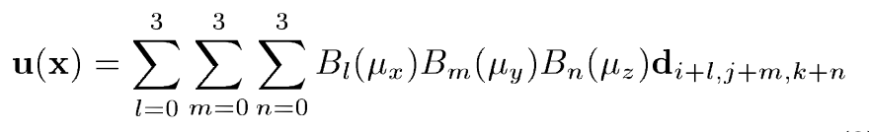
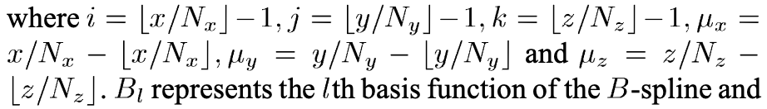
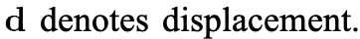
Free form deformations (FFDs)³
Free-form deformations (FFDs) is one of the most common types of transformation models in medical image registration. A rectangular grid G = K_{x} x K_{y} x K_{z} is superimposed on the image (size N_{x} x N_{y} x N_{z}, K_{x}<<N_{x}, K_{y}<<N_{y}, K_{z}<<N_{z}) that gets deformed under the influence of the control points. The dense deformation is given as a summation of tensor products of univariate splines. The displacement field is given by:

Slide 35
Free form deformations (FFDs)
Advantages of FFDs:³
This transformation model is simple
Can efficiently provide smooth deformations.
Requires few degrees of freedom to describe local deformations.
Further literature review and details are provided in [3]

Slide 36
Matching criteria
We can distinguish registration methods using similarity criteria according to the type of information they exploit.
There are several approaches for both whether we’re dealing with a mono-modal or a multi-modal registration problem. In the mono-modal case, the use of standard similarity criteria (e.g., SSD or SAD) involving either intensities or multi-channel data extracted from the image through the application of filters is well-accepted by the community. In the multi-modal case, the use of information theoretic measures has become the prevalent solution.

Slide 37
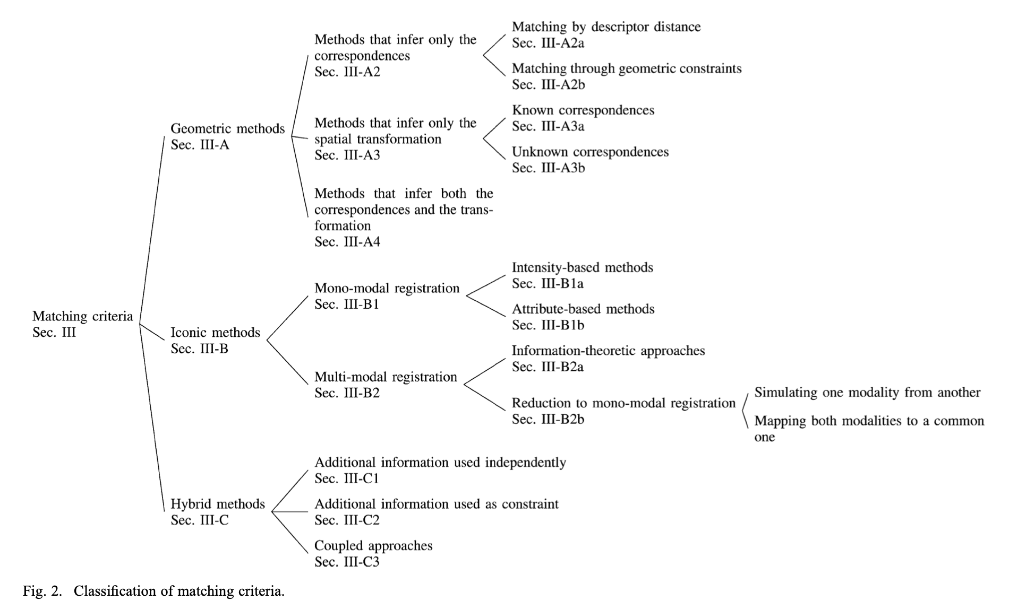
Matching criteria³

Slide 38
Optimization methods³
The aim of optimization is to infer the optimal transformation that best aligns two images according to an objective function comprising a matching term and a regularization term. Optimization methods may be separated into two categories based on the nature of the variables that they try to infer:
continuous, and
discrete.
The first class of methods solves optimization problems where the variables assume real values. On the contrary, methods in the second class solve problem the variables take values from a discrete set. Both classes of methods are constrained with respect to the nature of the objective function as well as the structure to be optimized.

Slide 39
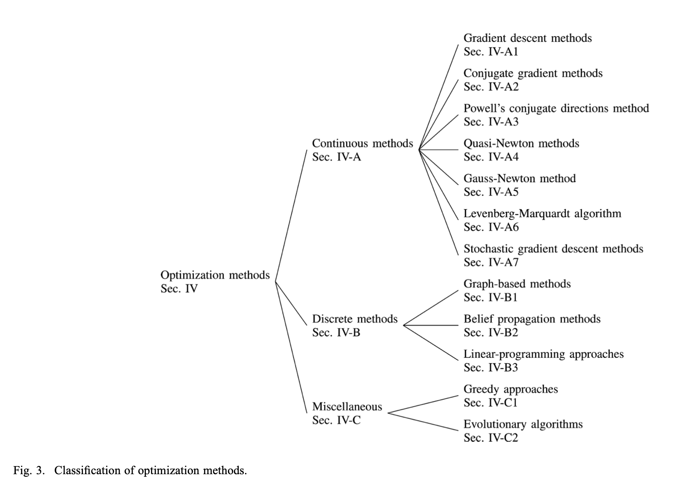
Optimization methods

Slide 40
Optimization methods
Registration is an inherently continuous problem. As a consequence, continuous optimization methods have been the main driving force behind registration algorithms. Recently, discrete optimization techniques have been proposed to tackle deformable registration.
These methods have been described in complete detail in survey paper [3].

Slide 41
Difficulty in evaluation of registration methods³
Evaluation of registration methods is a particularly difficult problem because of the lack of a “ground truth.” The absence of knowledge of correspondences between images makes the quantitative validation of the registration performance a challenging task. Moreover, because of the different requirements of the applications that are based on deformable registration, the notion of correspondence should vary according to application context, aiming to properly characterize error.
Nonetheless, the increasing availability of annotated data sets (e.g., the LONI Probabilistic Brain Atlas¹⁷, the Internet Brain Segmentation Repository - IBSR¹⁸, the CUMC12 dataset2 acquired at the Columbia University Medical Center, the MGH10 dataset2 scanned at the MGH/MIT/HMS Athinoula A. Martinos Center for Biomedical Imaging) which has lead to several evaluation studies described in [19].
Moreover, the development of evaluation projects for image registration (i.e., nonrigid image registration evaluation project—NIREP ²⁰) and the increasing understanding regarding the use of surrogate measures for the measurement of the accuracy of registration will further facilitate the comparison between different algorithms.

Slide 42
Deformable image registration using python libraries
https://pypi.org/project/pystackreg/
https://github.com/Ilovemirrors/python_for_microscopists
https://pypi.org/project/itk-registration/
http://pyimreg.github.io/

Slide 43
References
A. Ardeshir Goshtasby, “2-D and 3-D Image Registration for Medical, Remote Sensing, and Industrial Applications”, Wiley Press, 2005.
R. Haase, “14a Image Registration”, July 5, 2020, YouTube video, 12:57, url: https://www.youtube.com/watch?v=3CGC-5vwraM.
A. Sotiras, C. Davatzikos and N. Paragios, "Deformable Medical Image Registration: A Survey," in IEEE Transactions on Medical Imaging, vol. 32, no. 7, pp. 1153-1190, July 2013, doi: 10.1109/TMI.2013.2265603.
E. D’Agostino, F. Maes, D. Vandermeulen, and P. Suetens, “A viscous fluid model for multimodal non-rigid image registration using mutual information,” Med. Image Anal., vol. 7, no. 4, pp. 565–575, 2003.
J.-P. Thirion, “Image matching as a diffusion process: An analogy with Maxwell’s demons,” Med. Image Anal., vol. 2, no. 3, pp. 243–260, 1998.
X. Pennec, P. Cachier, and N. Ayache, “Understanding the “Demon’s algorithm”: 3D non-rigid registration by gradient descent,” in Int. Conf. Med. Image Comput. Comput.-Assist. Intervent., 1999, pp. 597–606.
T. Vercauteren, X. Pennec, A. Perchant, and N. Ayache, “Non-parametric diffeomorphic image registration with the demons algorithm,” in Proc. Int. Conf. Med. Image Comput. Comput.-Assist. Intervent., 2007, pp. 319–326.

Slide 44
References
T. Vercauteren, X. Pennec, A. Perchant, and N. Ayache, “Symmetric log-domain diffeomorphic registration: A demons-based approach,” in Int. Conf. Med. Image Comput. Comput.-Assist. Intervent., 2008, pp. 754–761.
A. Guimond, A. Roche, N. Ayache, and J. Meunier, “Three-dimensional multimodal brain warping using the demons algorithm and adaptive intensity corrections,” IEEE Trans. Med. Imag., vol. 20, no. 1, pp. 58–69, Jan. 2001.
A. Tristán-Vega, G. Vegas-Sánchez-Ferrero, and A.-F. Santiago, “Local similarity measures for demons-like registration algorithms,” in Proc. Int. Symp. Biomed. Imag., 2008, pp. 1087–1090.
M. Modat, T. Vercauteren, G. R. Ridgway, D. J. Hawkes, N. C. Fox, and S. Ourselin, “Diffeomorphic demons using normalized mutual information, evaluation on multimodal brain MR images,” in Proc. SPIE Med. Imag.: Image Process., 2010, pp. 76 232K-1–76-232K-8.
J.-M. Peyrat, H. Delingette, M. Sermesant, X. Pennec, C. Xu, and N. Ayache, “Registration of 4D time-series of cardiac images with multichannel diffeomorphic demons,” in Proc. Int. Conf. Med. Image Comput. Comput.-Assist. Intervent., 2008, pp. 972–979.
B. T. T. Yeo, T. Vercauteren, P. Fillard, J.-M. Peyrat, X. Pennec, P. Golland, N. Ayache, and O. Clatz, “DT-REFinD: Diffusion tensor registration with exact finite-strain differential,” IEEE Trans. Med. Imag., vol. 28, no. 12, pp. 1914–1928, Dec. 2009.
B. T. T. Yeo, M. R. Sabuncu, T. Vercauteren, N. Ayache, B. Fischl, and P. Golland, “Spherical demons: Fast diffeomorphic landmark-free surface registration,” IEEE Trans. Med. Imag., vol. 29, no. 3, pp. 650–668, Mar. 2010.

Slide 45
References
S. Nag, “Image Registration Techniques: A Survey”, arXiv preprint, arXiv: 1712.07540, 28 Nov 2017.
F. Maes, A. Collignon, D. Vandermeulen, G. Marchal, and Suetens, “Multimodality image registration by maximization of mutual information,” IEEE Transactions on Medical Imaging, vol. 16, no. 2, (1997), 187–198
D. W. Shattuck, M. Mirza, V. Adisetiyo, C. Hojatkashani, G. Salamon, K. L. Narr, R. A. Poldrack, R. M. Bilder, and A. W. Toga, “Construction of a 3d probabilistic atlas of human cortical structures,” NeuroImage, vol. 39, no. 3, pp. 1064–1080, 2008.
Massachusetts General Hospital Center for Morphometric Analysis, Internet brain segmentation repository [Online]. Available: http://www.cma.mgh.harvard.edu/ibsr/
A. Klein, J. Andersson, B. A. Ardekani, J. Ashburner, B. Avants, M.-C. Chiang, G. E. Christensen, D. L. Collins, J. Gee, P. Hellier, J. H. Song, M. Jenkinson, C. Lepage, D. Rueckert, P. Thompson, T. Vercauteren, R. P. Woods, J. J. Mann, and R. V. Parsey, “Evaluation of 14 nonlinear deformation algorithms applied to human brain mri registration,” NeuroImage, vol. 46, no. 3, pp. 786–802, 2009.
G. Christensen, X. Geng, J. Kuhl, J. Bruss, T. Grabowski, I. Pirwani, M. Vannier, J. Allen, and H. Damasio, “Introduction to the non-rigid image registration evaluation project (NIREP),” in Proc. Int. Workshop Biomed. Image Registrat., 2006, pp. 128–135.

